Slide 1

Ethics, Bias, and Fairness Part II
Rayid Ghani and Kit Rodolfa

Slide 2
Short Quiz

Slide 3
Reminders
This week:
No class / project check-ins on Wednesday/Thursday
Coming up next week:
Update assignment – update/fix issues pointed out this week and earlier
Readings for Tuesday: causality and field validation

Slide 4
Plan for the week
What you should be working on with your team this week (and next week)
Finalize model selection (based on model performance and bias analysis)
Review entire pipeline – sanity checks and completeness (features, grid, etc.)
Review what’s needed for final presentation and report

Slide 5
Scope
Data
Exploration
Modeling
Get Data
Store Data
Link Data
Rows
Features
Labels
Model Selection
Train-Test Splits
Performance Metrics
Model Interpretation
Entities
temporal
Spatial
…
Models
Dealing with Bias and Fairness
Field Trial Design
Deployment
Monitoring
Goals, Actions, Data, Analysis, Ethics

Slide 6
Bias and Fairness Workflow
Define
Understand (root causes)
Improve (fairness)
Measure/ Detect (bias)
Mitigate (the impact)
Monitor &
Evaluate
- Metrics(s)
- Groups
- Audit model(s) for bias across metric(s) and groups
Data
ML pipeline components
Actions
Pre-Processing
Modeling (e.g. regularization)
Post-processing
Design appropriate actions

Slide 7
Bias and Fairness Workflow
Define
Understand (root causes)
Improve (fairness)
Measure/ Detect (bias)
Mitigate (the impact)
Monitor &
Evaluate
- Metrics(s)
- Groups
- Audit model(s) for bias across metric(s) and groups
Data
ML pipeline components
Actions
Pre-Processing
Modeling (e.g. regularization)
Post-processing
Design appropriate actions

Slide 8
Many Bias Measures: How do we select what we care about?

Slide 9
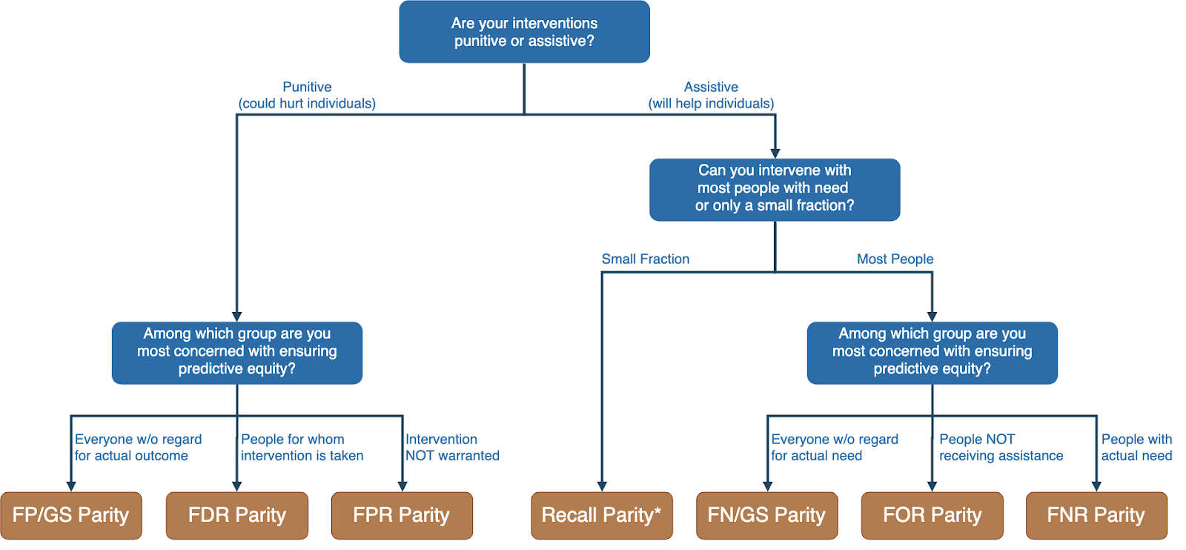
Translating policy goals to fairness metrics

Slide 10
Bias and Fairness Workflow
Define
Understand (root causes)
Improve (fairness)
Measure/ Detect (bias)
Mitigate (the impact)
Monitor &
Evaluate
- Metrics(s)
- Groups
- Audit model(s) for bias across metric(s) and groups
Data
ML pipeline components
Actions
Pre-Processing
Modeling (e.g. regularization)
Post-processing
Design appropriate actions

Slide 11

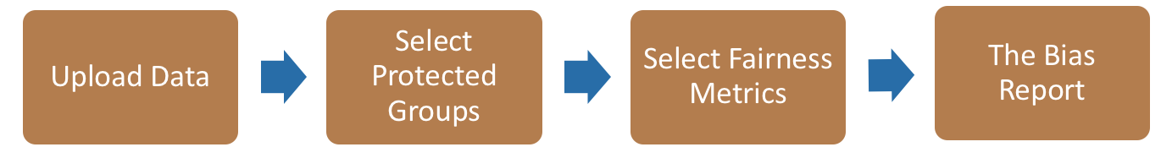
Bias Audit Flow
Race
Sex
Age
Equal False
Omission Rate
Risk Score and Outcomes

Slide 12
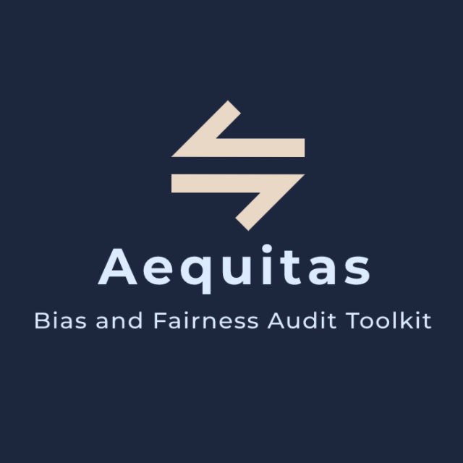
Bias Audit
http://www.datasciencepublicpolicy.org/aequitas/

Slide 13
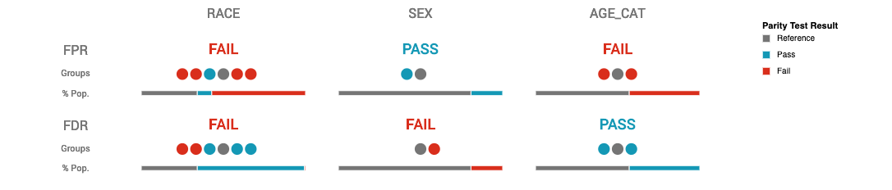
Auditing COMPAS Disparities

Slide 14
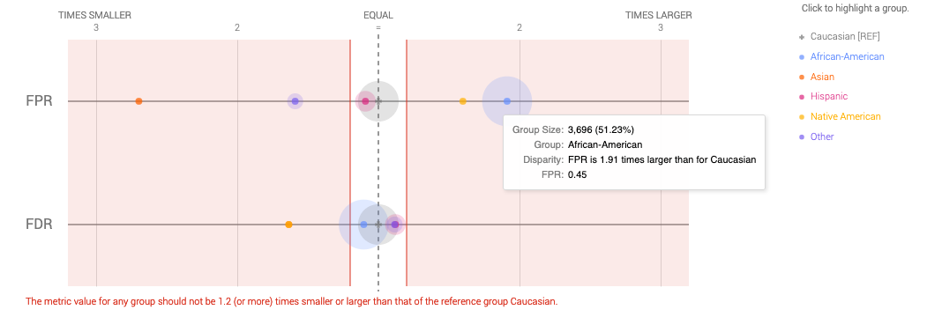
Auditing COMPAS Disparities

Slide 15
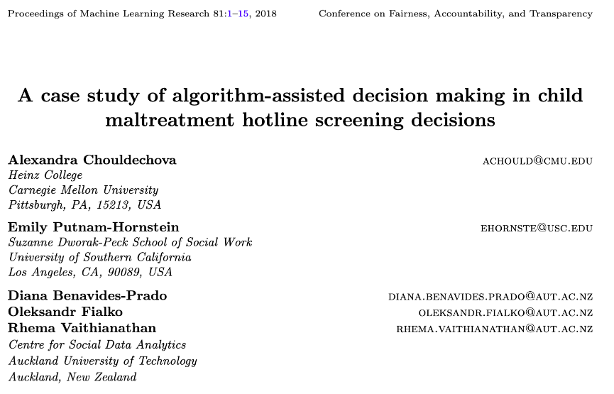
Child Welfare Case Study

Slide 16
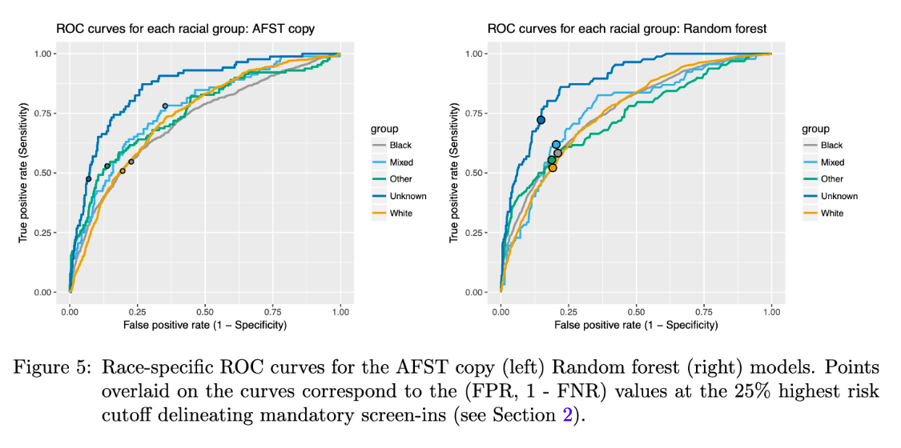
Child Welfare Case Study

Slide 17
Child Welfare Case Study
“We see that even though the ROC curves lie quite close to one another for most groups, the chosen threshold corresponds to different points on the ROC curves for different groups…. This FPR imbalance could lead to a perception that Mixed-race families are over- investigated relative to White families.
”

Slide 18
Bias and Fairness Workflow
Define
Understand (root causes)
Improve (fairness)
Measure/ Detect (bias)
Mitigate (the impact)
Monitor &
Evaluate
- Metrics(s)
- Groups
- Audit model(s) for bias across metric(s) and groups
Data
ML pipeline components
Actions
Pre-Processing
Modeling (e.g. regularization)
Post-processing
Design appropriate actions

Slide 19
Bias (in outcomes) can come from any of these four components
World
ML Pipeline
Actions
Data
Sample Bias
Measurement Bias
Label Bias
System Developers
Complexity or flaws
Design Choices

Slide 20
Bias and Fairness Workflow
Define
Understand (root causes)
Improve (fairness)
Measure/ Detect (bias)
Mitigate (the impact)
Monitor &
Evaluate
- Metrics(s)
- Groups
- Audit model(s) for bias across metric(s) and groups
Data
ML pipeline components
Actions
Pre-Processing
Modeling (e.g. regularization)
Post-processing
Design appropriate actions

Slide 21
Improving Fairness of Models
Pre-Processing: Try to fix the input data
In-Processing: Optimize for fairness in model training
Model Selection: Choose fair models during model selection
Post-Processing: Post-hoc adjustments to de-bias model scores

Slide 22
Fairness-aware Model Selection
0%
Performance Metric
100%

Slide 23
Fairness-aware Model Selection
100%
Bias
0%
Performance Metric
100%

Slide 24
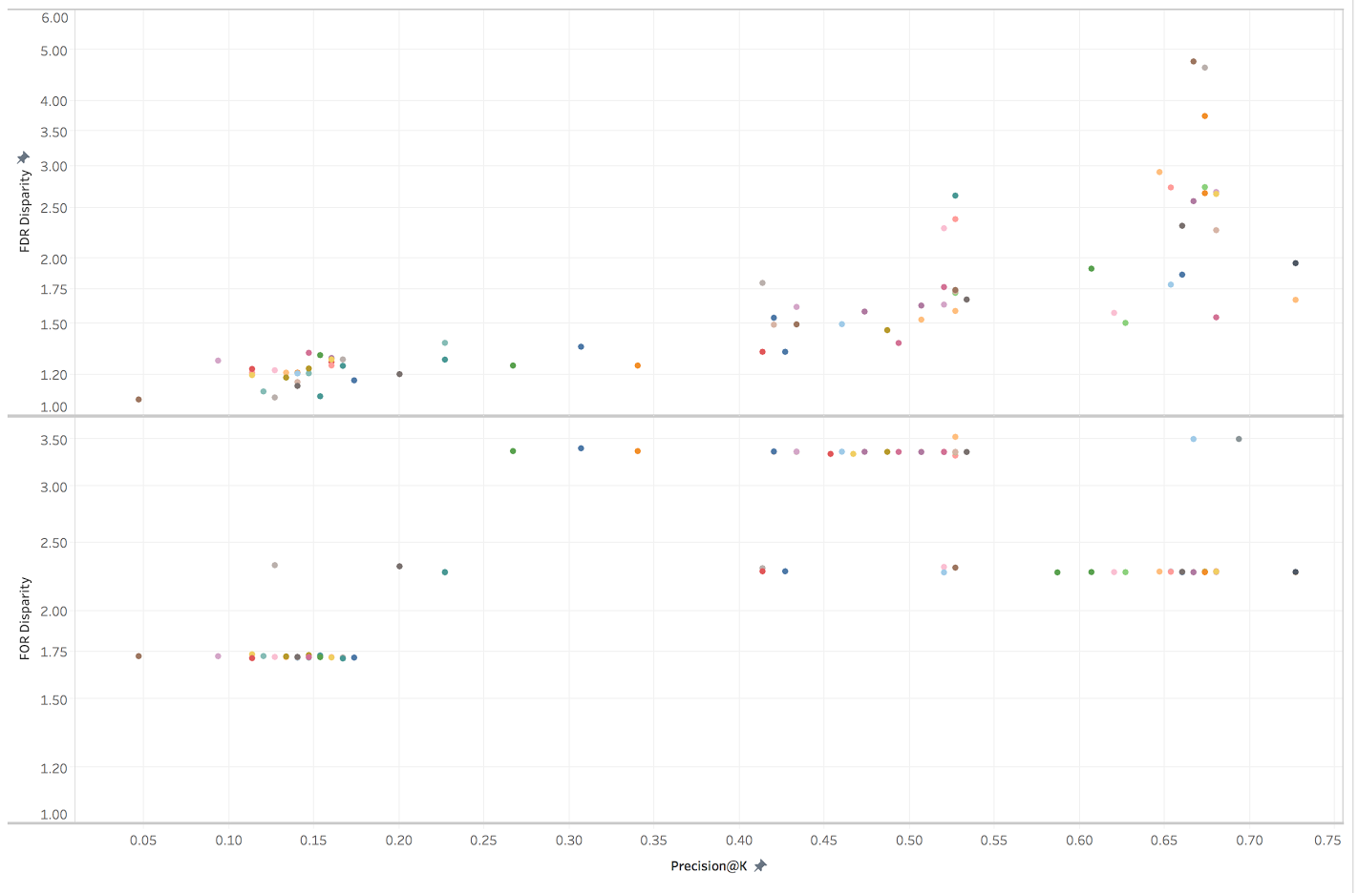
Fairness-aware Model Selection
Bias vs P@1% on Gender
False Discovery Rate Disparity
False Omission Rate Disparity
Precision at the top 1%

Slide 25
Improving Fairness of Models
Pre-Processing: Try to fix the input data
In-Processing: Optimize for fairness in model training
Model Selection: Choose fair models during model selection
Post-Processing: Post-hoc adjustments to de-bias model scores

Slide 26
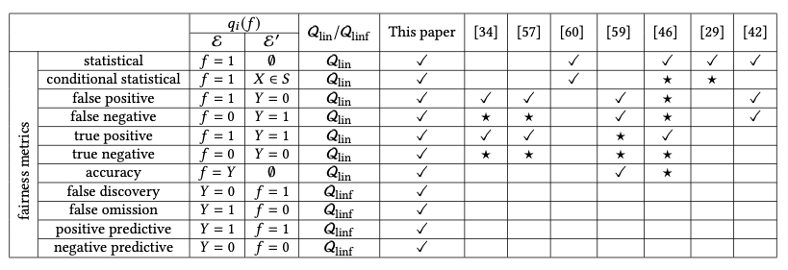
Optimize for Fairness in Model Training
General idea: modify optimization problem (for instance, by adding regularization terms to loss function) that account for fairness. Many implementations of different methods for various fairness metrics.

Slide 27
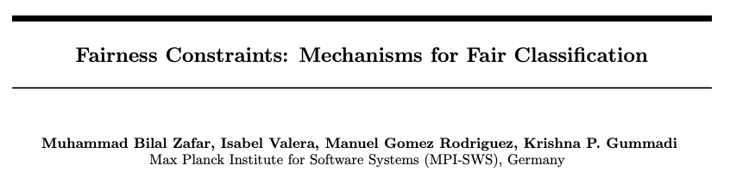
Optimize for Fairness in Model Training

Slide 28
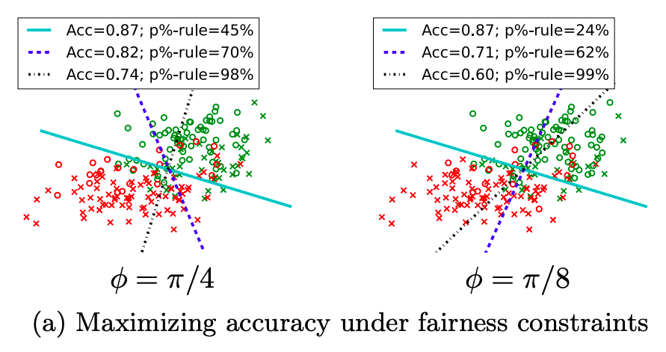
Optimize for Fairness in Model Training

Slide 29
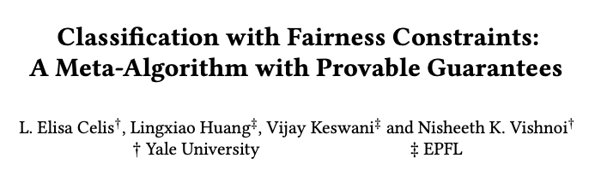
Optimize for Fairness in Model Training

Slide 30
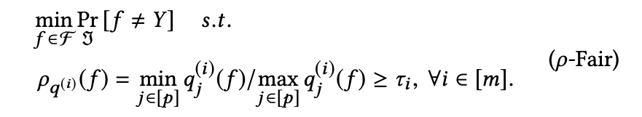
Optimize for Fairness in Model Training

Slide 31
Optimize for Fairness in Model Training
“group performance function”
capturing the equity metric
of interest

Slide 32
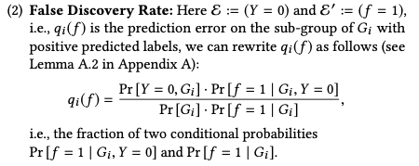
Optimize for Fairness in Model Training
for example:

Slide 33
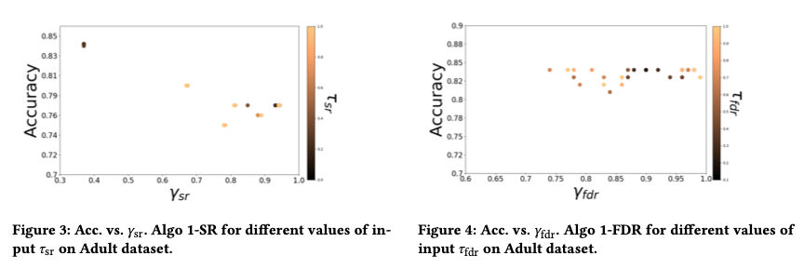
Optimize for Fairness in Model Training

Slide 34
Optimize for Fairness in Model Training: Advantages
Idea of an “all-in-one” solution is appealing
Provides some flexibility, especially when group membership not known exactly (e.g., gender estimated from name or race from census data)

Slide 35
Optimize for Fairness in Model Training: Limitations
Limited set of algorithms to do this directly, though also black-box options (often end up doing the same thing as post-hoc score adjustments)
Doesn’t preclude the need to auditing, assessment, and model selection – need to confirm the effectiveness of the constraint!
Generally don’t work well for “top k” problems off the shelf

Slide 36
Improving Fairness of Models
Pre-Processing: Try to fix the input data
In-Processing: Optimize for fairness in model training
Model Selection: Choose fair models during model selection
Post-Processing: Post-hoc adjustments to de-bias model scores

Slide 37
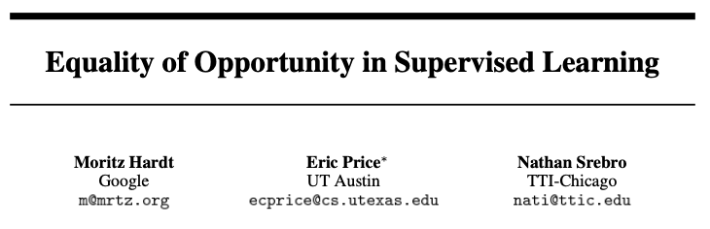
Post-hoc Adjustments

Slide 38
Post-hoc Adjustments
aka recall or TPR

Slide 39
Post-hoc Adjustments
“That is, to require that people who pay back their loan have an equal opportunity of getting a loan in the first place.
”

Slide 40
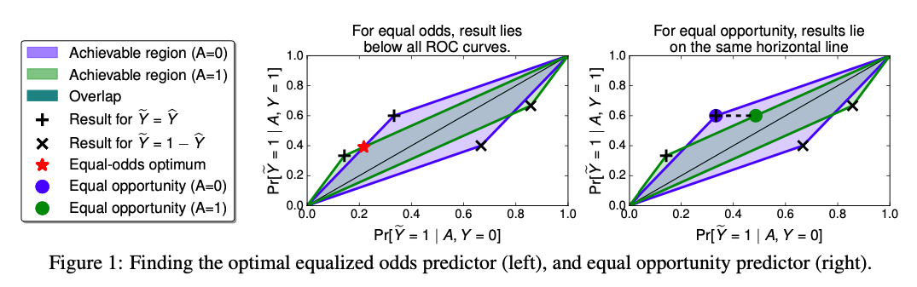
Post-hoc Adjustments

Slide 41
Case Study: Post-hoc Adjustments and Policy Goals
Cycle of Incarceration
UNMET
NEEDS
MISDEMEANOR
ARREST
JAIL
worsening or failing to improve

Slide 42
Case Study: Post-hoc Adjustments and Policy Goals
Breaking the Cycle
UNMET
NEEDS
X
MISDEMEANOR
ARREST
JAIL
TAILORED
INTERVENTION

Slide 43
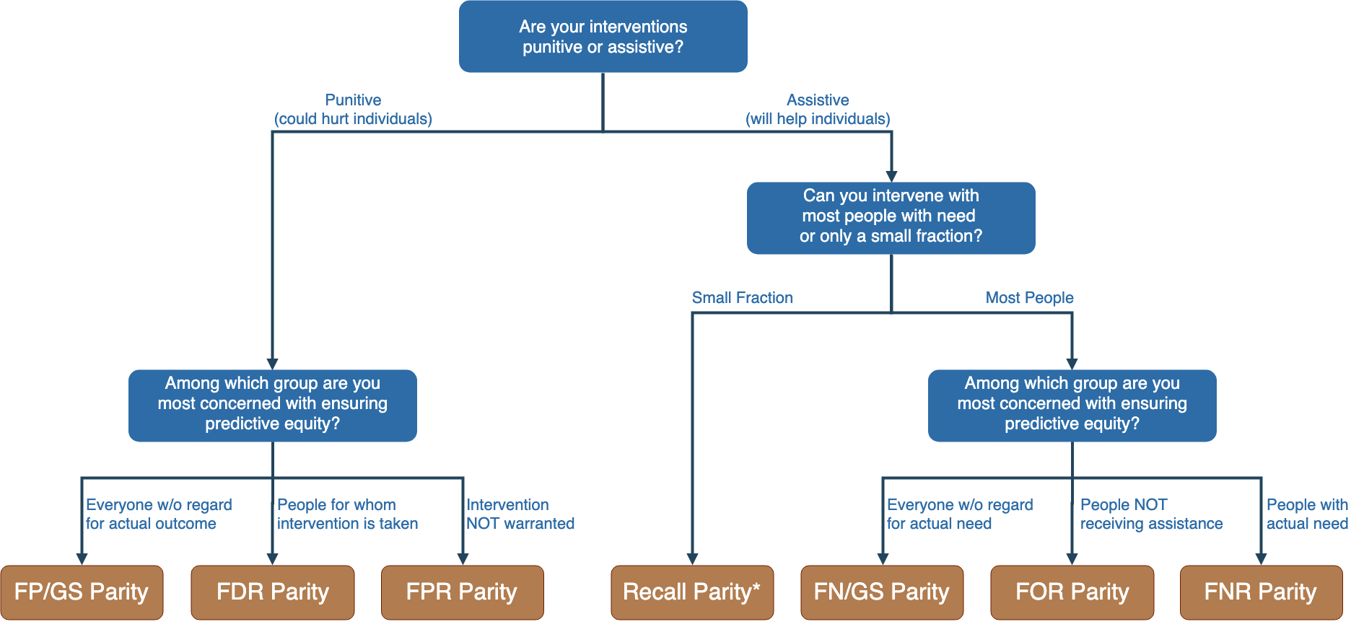
Notes:
Context-dependence of fairness definition
Idea of fairness tree is starting point for conversations with stakeholders, help guide discussion
In assistive program with resource constraints, focus on recall parity (equivalent to equality of opportunity discussed by Hardt and others --- also “sensitivity” and TPR and 1-FNR)

Slide 44
Notes:
Context-dependence of fairness definition
Idea of fairness tree is starting point for conversations with stakeholders, help guide discussion
In assistive program with resource constraints, focus on recall parity (equivalent to equality of opportunity discussed by Hardt and others --- also “sensitivity” and TPR and 1-FNR)

Slide 45
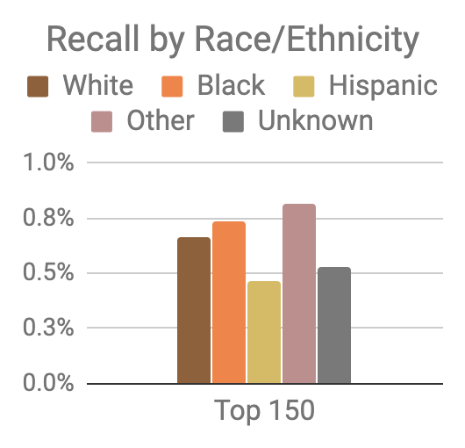
Model was optimized for efficiency, not equity
Top 150 highest risk reasonably balanced between black and white individuals
However, hispanic and unknown race/ethnicity groups very underrepresented

Slide 46
Mitigating Disparities
Single Threshold
White
Black
Hispanic
Recall
Lower Scores / Higher Recall
Group Thresholds
Recall

Slide 47
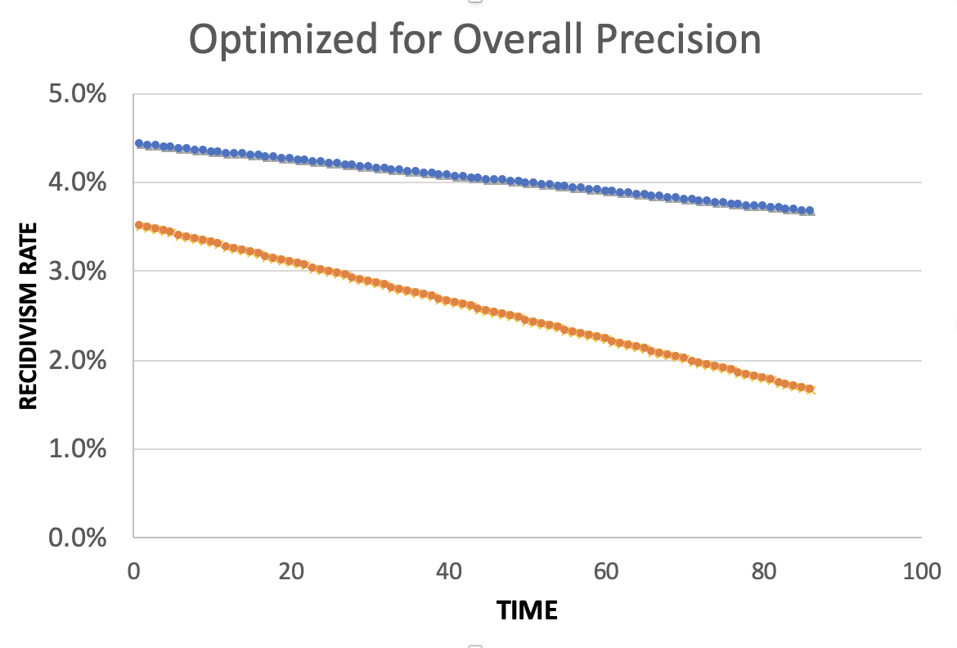
Equality of Predictions vs Underlying Disparities
Widening Gap:
Disparities Getting
Larger Over Time

Slide 48
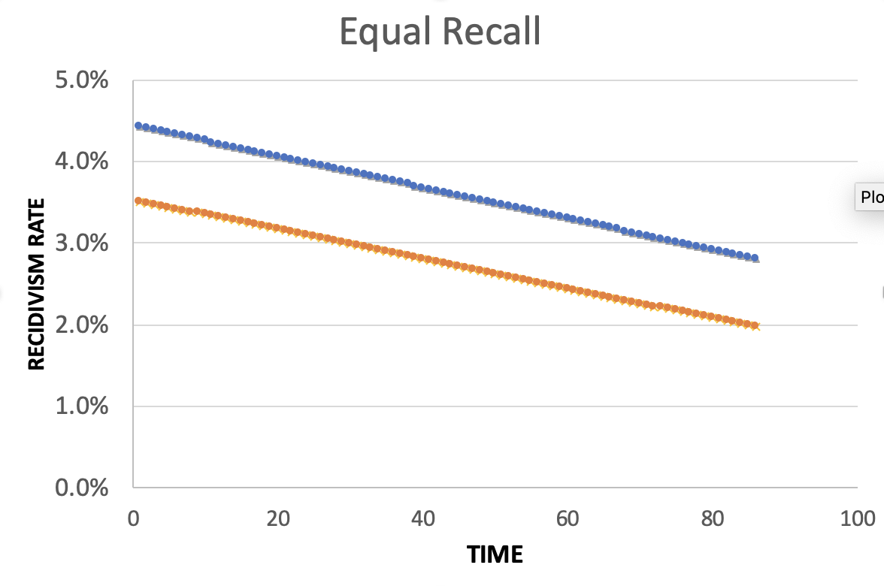
Equality of Predictions vs Underlying Disparities
Parallel Lines:
Disparities Remain
Constant Over Time

Slide 49
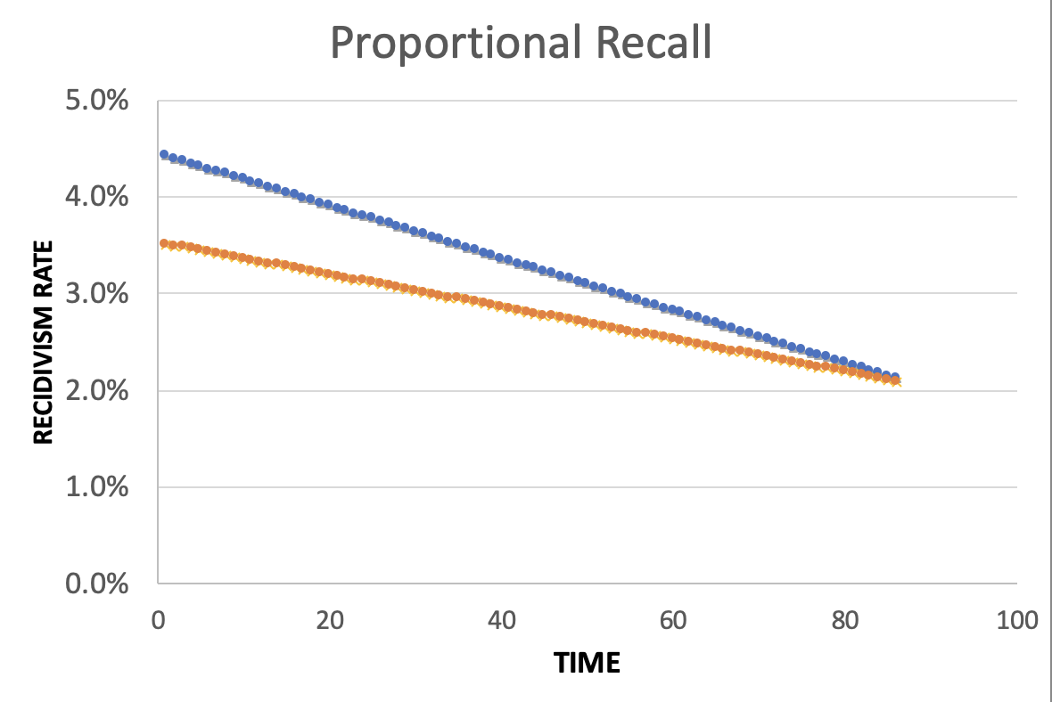
Equality of Predictions vs Underlying Disparities
Converging Lines:
Disparities Decrease
Over Time

Slide 51
Menu of Options
Current Scale
Expanded Scale
No
Constraint
Equalize
Recall
Reduce
Disparities

Slide 52
Menu of Options
Current Scale
Expanded Scale
No
Constraint
INITIAL
MODEL
Equalize
Recall
Reduce
Disparities

Slide 53
Menu of Options
Current Scale
Expanded Scale
No
Constraint
Equalize
Recall
EXPLICIT
EQUITY / EFFICIENCY
TRADE-OFF
“COST OF
EQUITY”
Reduce
Disparities

Slide 54
Menu of Options
Current Scale
Expanded Scale
No
Constraint
Equalize
Recall
IMPROVE OUTCOMES AT SAME
RATE ACROSS GROUPS
Reduce
Disparities
IMPROVE OUTCOMES FASTER FOR GROUPS
WITH HIGHER INCARCERATION RATES
Notes:
For the “Reduce Disparities” options, we targeted recall levels in proportion to underlying prevalence in the population. Could make other choices, but this has the nice property of readjusting as these prevalences change while also still distributing resources across all groups, but one could reasonably take many possible approaches.

Slide 55
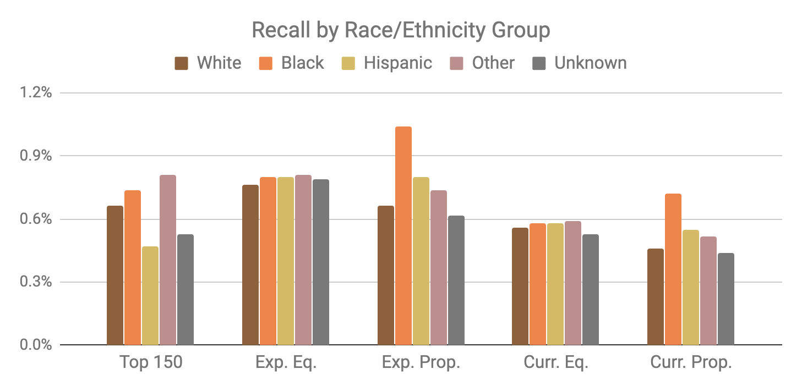
Base Model
Expanded Scale
Current Scale

Slide 56
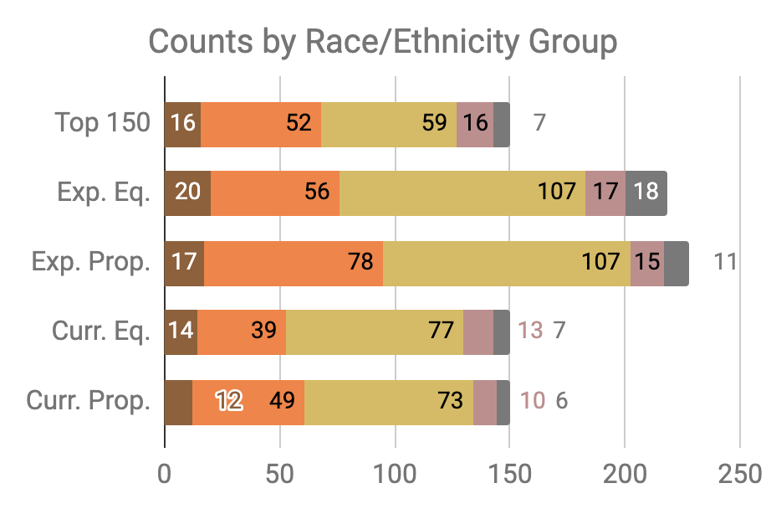

Slide 57
Little Equity/Efficiency Trade-Off at Current Scale
Top 150
72.7%
Precision
150
Total Count
Equal
Recall
70.7%
Precision
150
Total Count
Proportional
Recall
70.7%
Precision
150
Total Count

Slide 58
Improving Fairness of Models
Pre-Processing: Try to fix the input data
In-Processing: Optimize for fairness in model training
Model Selection: Choose fair models during model selection
Post-Processing: Post-hoc adjustments to de-bias model scores

Slide 59
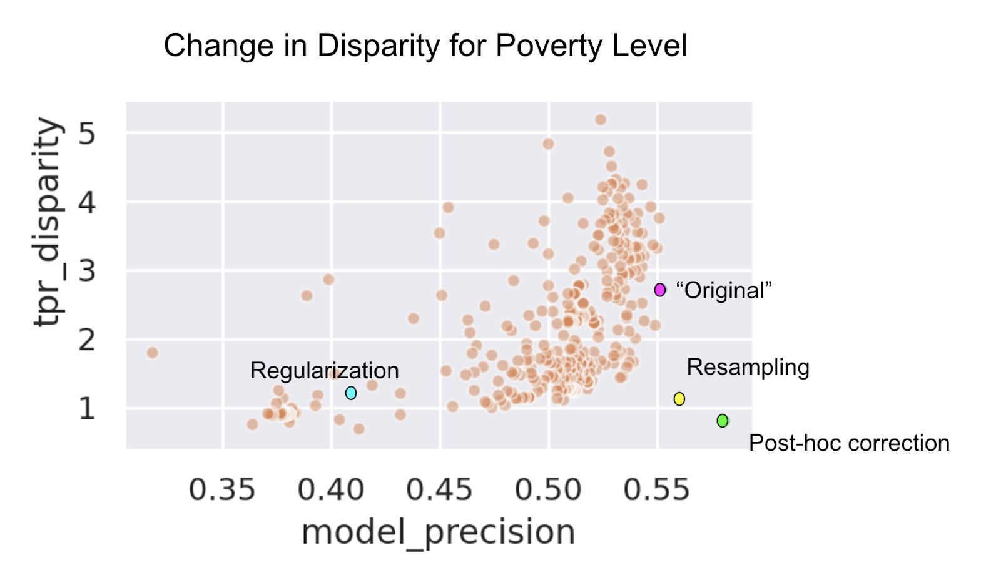

Slide 60
Data and AI Ethics Issues
Privacy
Data Ownership
Bias, Equity, & Fairness
Transparency
Trustworthiness and Accountability

Slide 61
Summary
Create an environment where informed ethical discussions can take place
Talk through ethical issues at each stage of the project (instead of waiting till the end of stopping after the initial setup)
Consider the entire chain of data - collection to analysis to action
Consider how it affects people throughout the chain – especially the people being affected (and include them in these discussions)
Embed ethics into both technical processes as well as people processes

Slide 62
Readings
Policy Paradox
Ethics and Data Science
Ethics and Policy in Data Science (Class at Cornell)
First, Do No Harm
FATML (workshops that have been happening for the past 4 years)

Slide 63
Useful resources we’ve created
Bias and Fairness in ML tutorial
Fairness Tree
Aequitas: Bias Audit Tool [description] [code]
Bias in ML Book Chapter

